Slide 1


01
SmartRose
AI-IOT PLATFORM FOR SMART GREENHOUSE ROSE FARMING IN SRI LANKA
25-26J-299

Slide 2



02
Problem Statement & Impact
Greenhouse rose cultivation in Sri Lanka lacks an affordable, integrated, and intelligent management system tailored to local climatic conditions and farming practices.
  Late disease detection leading to crop loss
  Overuse or imbalance of fertilizers and water
  Inconsistent flower quality and reduced yield
  High post-harvest losses due to poor freshness tracking
  Increased production cost and reduced profitability
  Focus on isolated functions.
  Designed for large-scale international greenhouses.
  Do not consider Sri Lankan climate, rose varieties, or farmer affordability.
  Ignore post-harvest freshness and vase-life management.
Middle-scale greenhouse rose farmers and florists rely on manual observation and experience-based decisions.

Slide 3
03
Proposed Solution
  SmartRose is an AI–IoT–based smart greenhouse management platform designed specifically for Sri Lankan greenhouse rose cultivation.
  It integrates real-time sensing, machine learning, and decision support into a single, low-cost, scalable system.
  Centralized Stress Prediction & Energy Optimization System
  Automated Early Disease Alerting System
  Intelligent Nutrition Management for Greenhouse Roses
  IoT Based Freshness Monitoring & Post harvest Management

Slide 4




04
Commercialization
Application cost: RS.20000(Per Month)
Target Audience:
  Middle Scale Greenhouse Rose Farmers
  Florists
FREE PLAN
PREMIUM PLAN
Free
RS.20000
per month

Slide 5
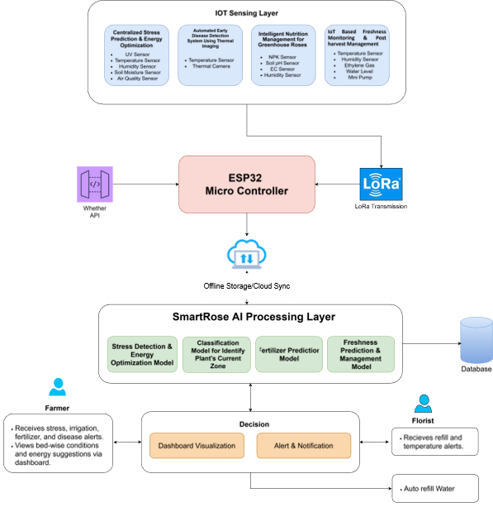

System Diagram
05

Slide 6
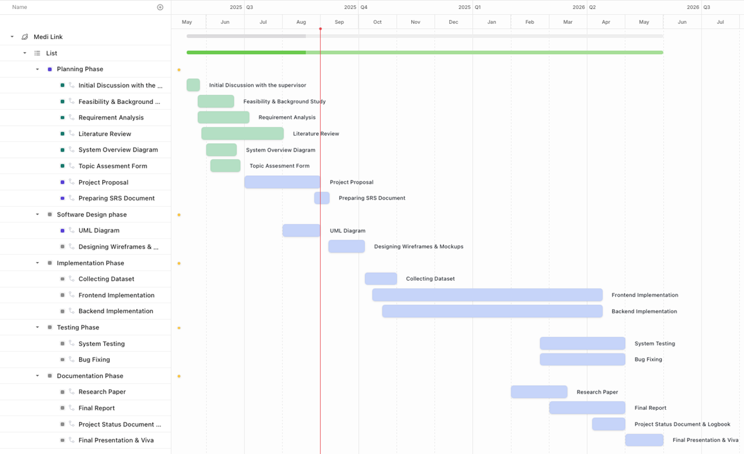
Gantt Chart
06

Slide 7

07
Automated Early Disease Alerting System
IT22358448- RAJAPAKSHA R M S N R
Information Technology Specialization

Slide 8
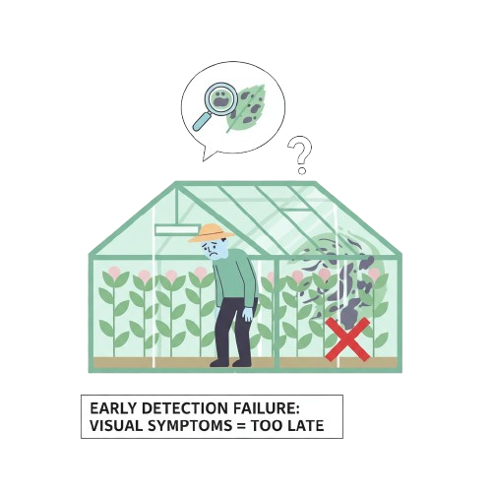

Automated Early Disease Alerting System
08
PROBLEM DEFINITION
  Middle-scale rose greenhouse farmers face a lack of early detection of major symptoms at the initial stage of most diseases.
  When visual symptoms appear, it is often too late for prevention.
IT22358448 | RAJAPAKSHA R M S N R | 25-26J-299

Slide 9
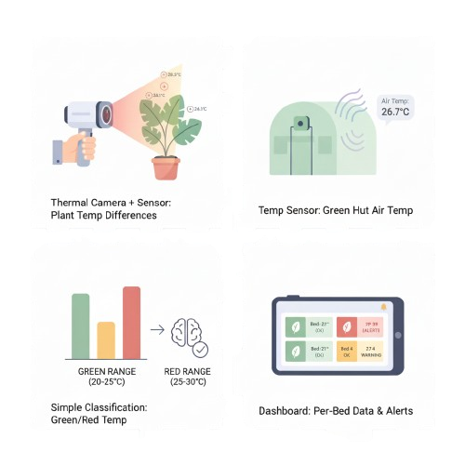
Automated Early Disease Alerting System
09
PROPOSED SOLUTION
  Thermal camera with temperature sensor module to detect plant temperature differences.
  Air temperature sensor for monitoring the green house environment.
  Simple classification model to identify green/red temperature ranges.
  Dashboard to visualize per-bed data and send alerts.
IT22358448 | RAJAPAKSHA R M S N R | 25-26J-299

Slide 10
Automated Early Disease Alerting System
02
02
02
10
Completion and Future works
Completed - 60%
Future works - 40%
IoT sensor readings
ML trainning with sensor data
Mobile Application Front End
ML predictions
Mount sensors to flower bed
alerting flower placement
IT22358448 | RAJAPAKSHA R M S N R | 25-26J-299

Slide 11
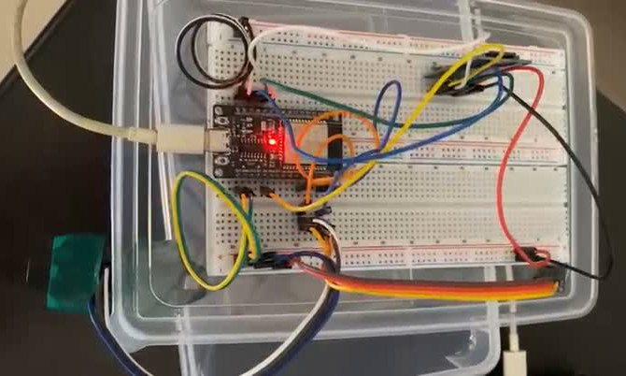
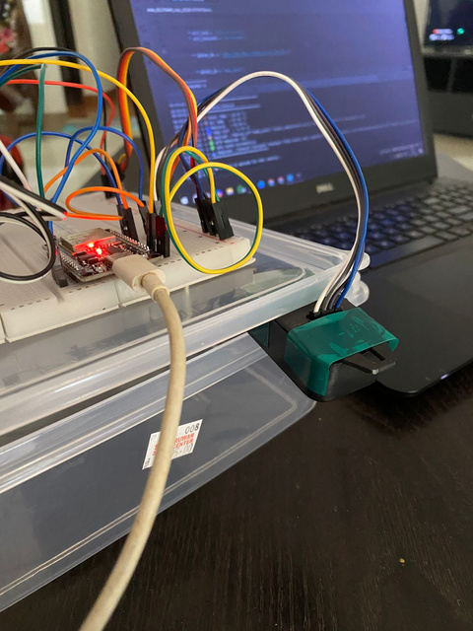
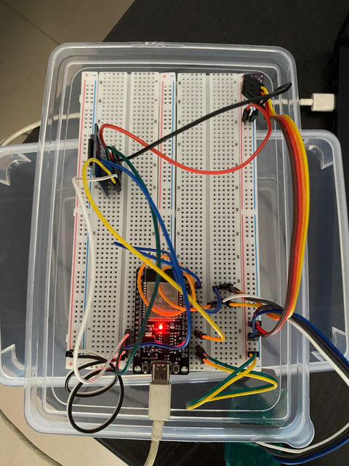
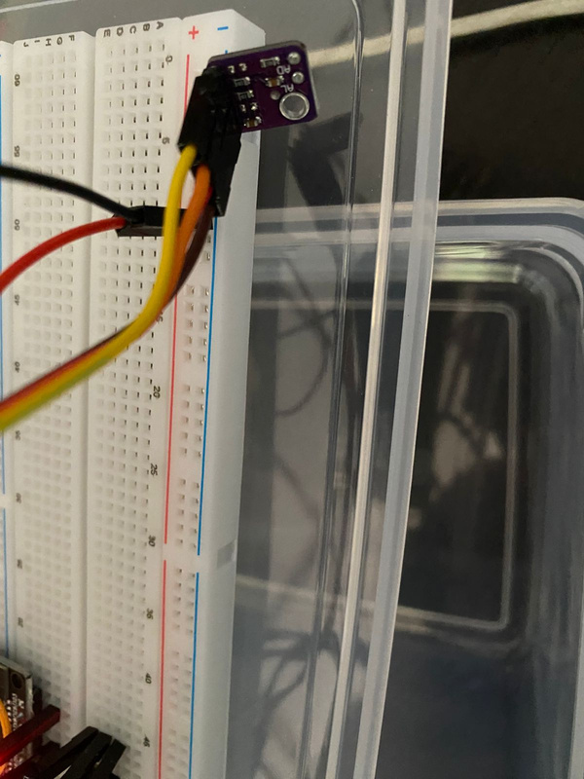
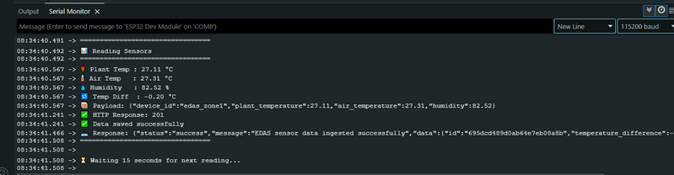
Automated Early Disease Alerting System
02
02
02
11
Evidence of Completion
IOT Integration, Testing and Data collection
IT22358448 | RAJAPAKSHA R M S N R | 25-26J-299

Slide 12
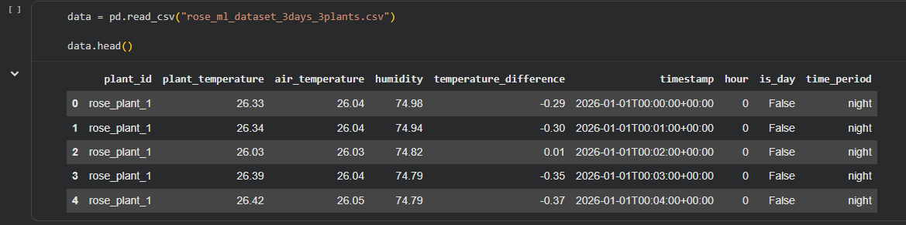
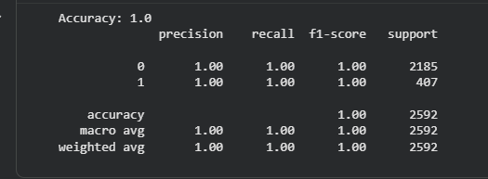
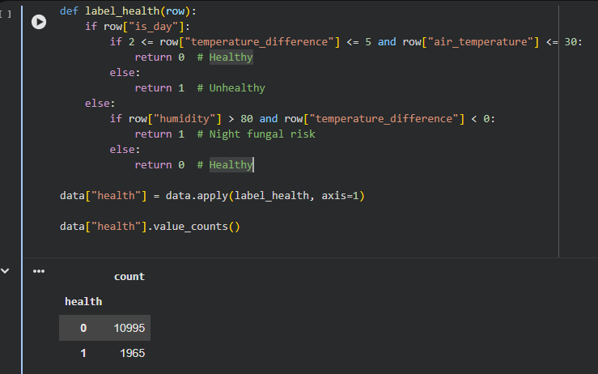
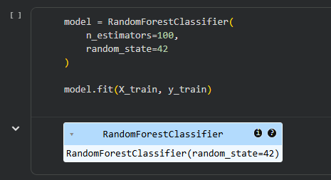
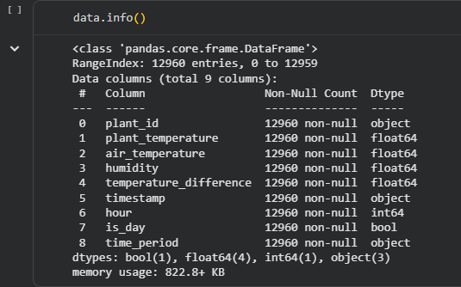
Automated Early Disease Alerting System
02
02
02
12
Evidence of Completion
Data Pre-Processing & Training the model
IT22358448 | RAJAPAKSHA R M S N R | 25-26J-299

Slide 13
Automated Early Disease Alerting System
02
02
02
13
Technologies, Techniques, Algorithms
Hardware
Techniques & Algorithms
  ESP32
  SHT30
  MLX90614
  Data preprocessing & normalization
  Random Forest Regressor
  Arduino IDE
  Flutter (Mobile App)
  FastAPI (Backend)
  MongoDB
  Python (ML)
  Google Collab
Software
IT22358448 | RAJAPAKSHA R M S N R | 25-26J-299

Slide 14
Automated Early Disease Alerting System
02
02
02
14
Functional, Non-Functional and User Requirements
Functional Requirements
  Real-time sensor data collection.
  Timestamp Management
  Data Storage
  Machine Learning Prediction
  Real-Time Data Update
  API Integration
  Historical Data Access
Non-Functional Requirements
  Performance : process incoming sensor data within 2 seconds of receipt. Support sensor data ingestion at 15-second intervals per device.
  Usability : present data using clear graphs, real-time values, and alerts. Display timestamps in local time for user clarity.
  Maintainability : follow modular architecture separating IoT ingestion, ML inference and Backend services.
User Requirements
Farmer :
  See real-time temperature and humidity values.
  Receive early warnings before visible disease symptoms appear.
  simple visual indicators
IT22358448 | RAJAPAKSHA R M S N R | 25-26J-299

Slide 15

IoT Based Freshness Monitoring & Post harvest Management
15
Bandara N G J C
Information Technology Specialization

Slide 16

IoT Based Freshness Monitoring & Post harvest Management
16
PROBLEM DEFINITION
  Roses lose freshness fast.
  Florists rely on guessing and experience.
  No real time freshness tracking system.
  Poor water and air quality.
  Water is manually changed and refilled.
  Need smart, low cost solution
IT22367594 | BANDARA N G J C | 25-26J-299

Slide 17


IoT Based Freshness Monitoring & Post harvest Management
02
02
02
17
PROPOSED SOLUTION
  Introduce a Smart Vase with built-in IoT sensors
  Continuously monitor temperature, humidity, ethylene in real time.
  Use AI model to predict vase life.
  Provide alerts
  Enable automatic water refilling
IT22367594 | BANDARA N G J C | 25-26J-299

Slide 18
IoT Based Freshness Monitoring & Post harvest Management
02
02
02
18
Completion and Future works
Completed - (50%+)
Future works
  IOT Sensor integration
  Freshness prediction model
  Freshness prediction model
  Mobile app integration
  Freshness Alerts
  Automatic water filling based on freshness score
IT22367594 | BANDARA N G J C | 25-26J-299

Slide 19
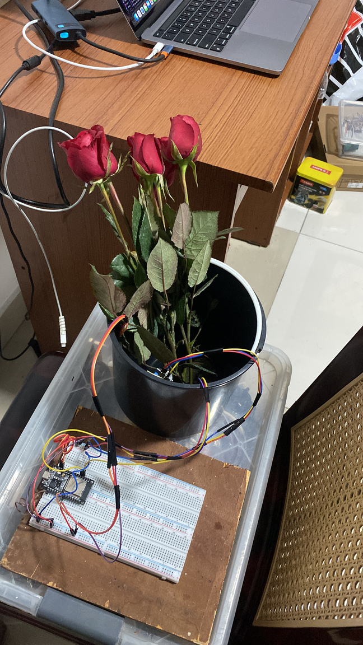
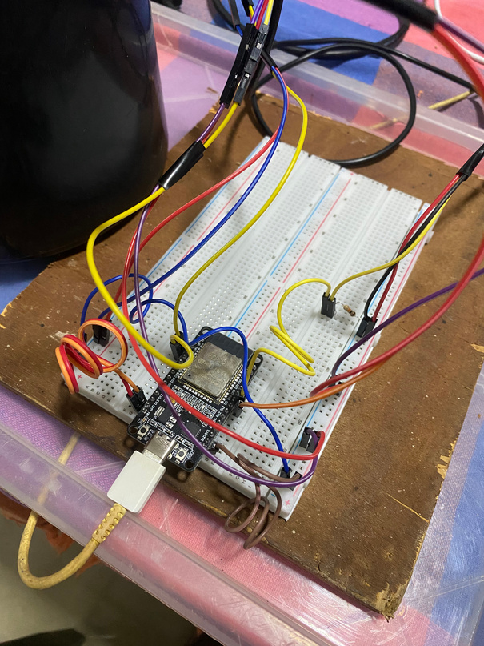
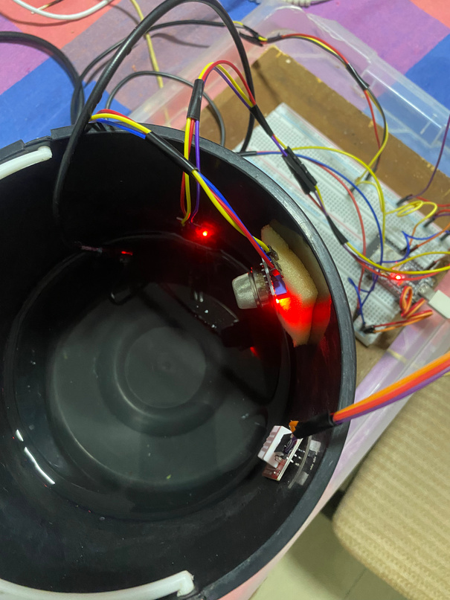
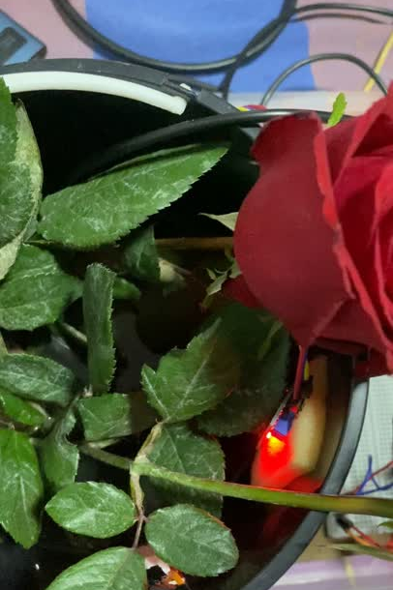
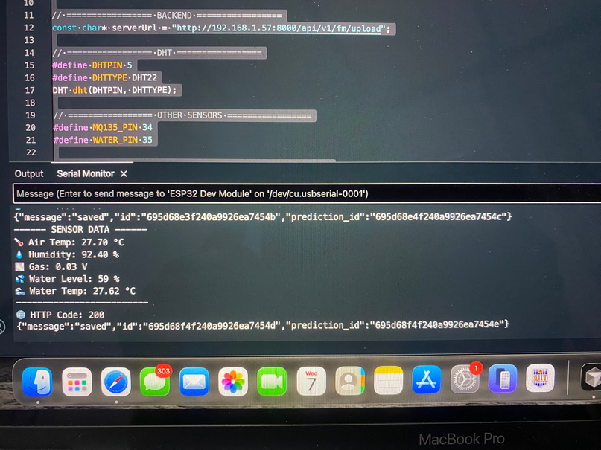
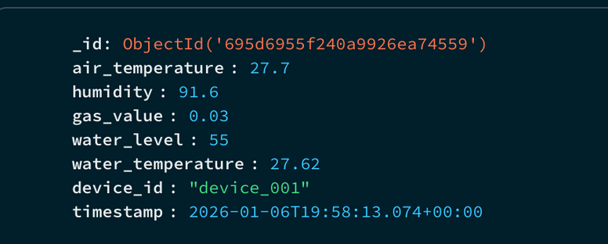
IoT Based Freshness Monitoring & Post harvest Management
02
02
02
19
Evidence of Completion
IOT Integration, Testing and Data collection
IT22367594 | BANDARA N G J C | 25-26J-299

Slide 20
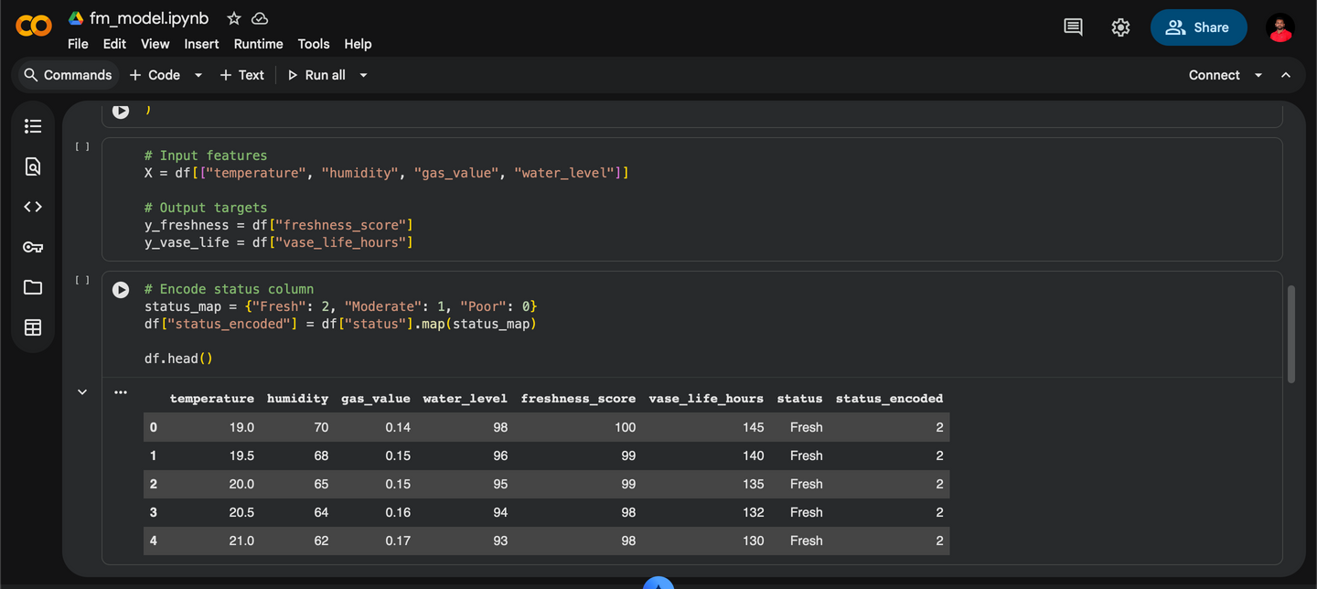
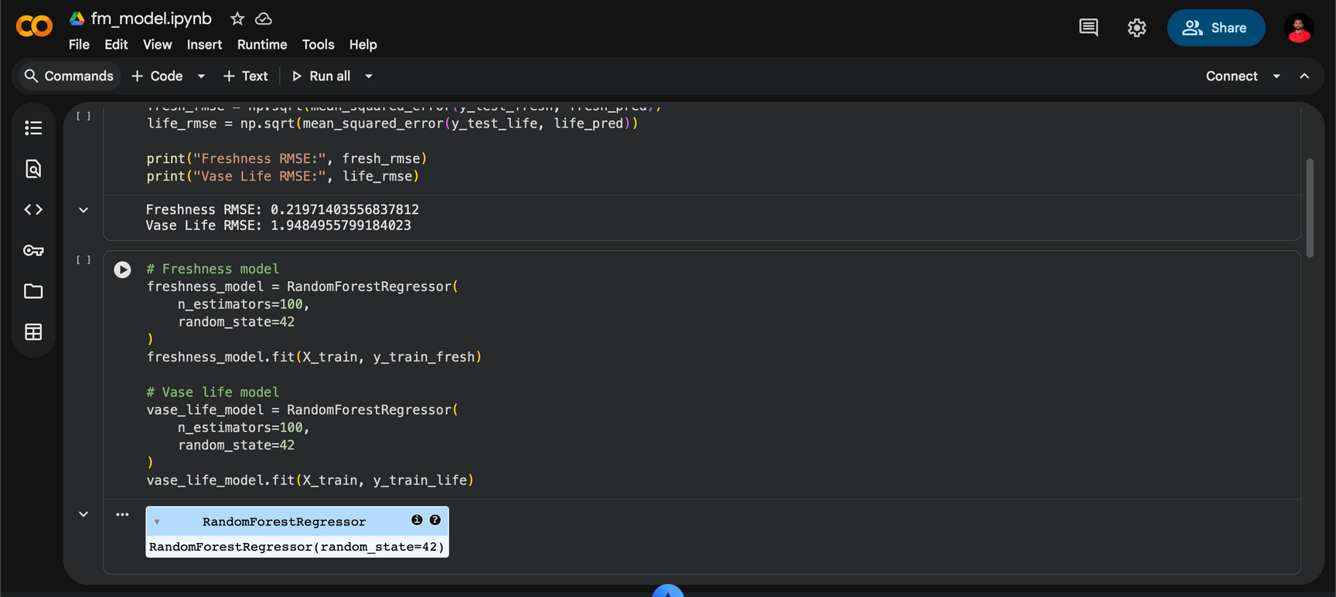
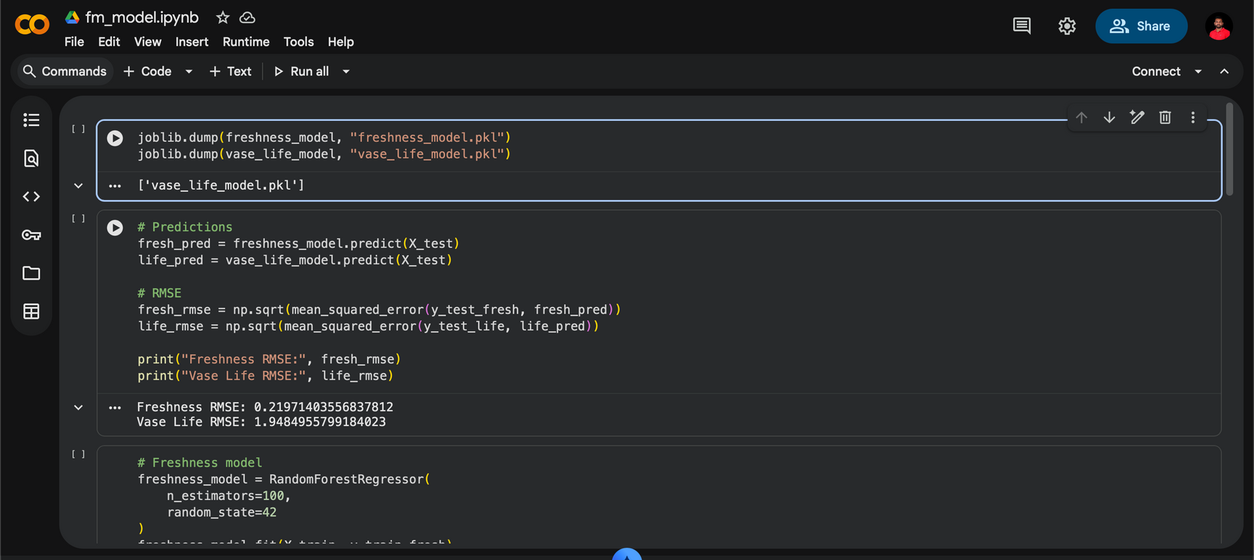
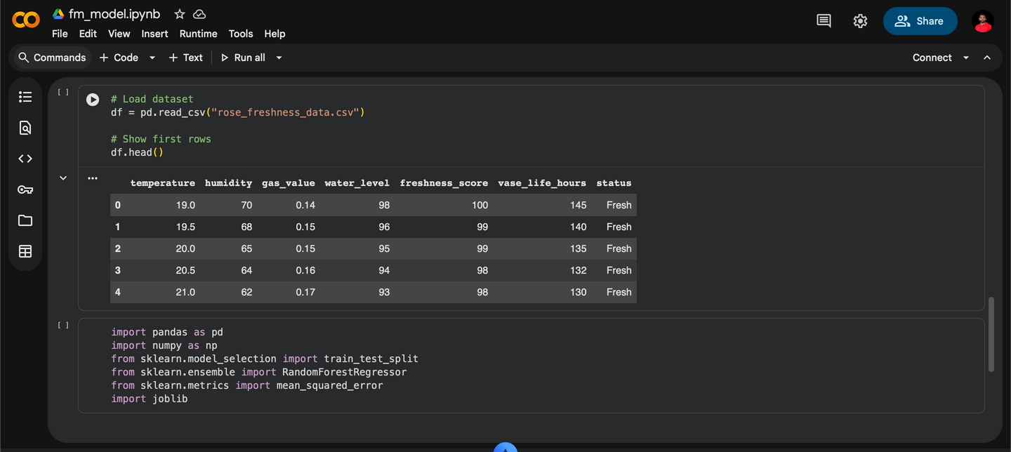
IoT Based Freshness Monitoring & Post harvest Management
02
02
02
20
Evidence of Completion
Data Pre-Processing & Training the model
IT22367594 | BANDARA N G J C | 25-26J-299

Slide 21
IoT Based Freshness Monitoring & Post harvest Management
02
02
02
21
Technologies, Techniques, Algorithms
Hardware
Software
  ESP32
  DHT22
  DS18B20
  MQ135 Gas Sensor
  Water Level Sensor
  Arduino IDE
  Flutter (Mobile App)
  FastAPI (Backend)
  MongoDB
  Python (ML)
  Google Collab
Techniques & Algorithm
  Data preprocessing & normalization
  Random Forest Regressor
IT22367594 | BANDARA N G J C | 25-26J-299

Slide 22
IoT Based Freshness Monitoring & Post harvest Management
02
02
02
22
Functional, Non-Functional and User Requirements
User Requirements
  View real-time flower freshness and environmental conditions.
  Receive alerts regarding temperature controls.
  Track historical freshness data for quality decisions.
Functional Requirements
  Monitor temperature, humidity, water level, and ethylene gas using IoT sensors.
  Predict freshness (0–100%) and remaining vase life using AI.
  Display real-time sensor and freshness data on a mobile dashboard.
  Provide access to historical freshness and sensor data.
  Enable automatic water refilling based on freshness score.
  Send alerts and notifications to florists for critical conditions.
Non-Functional Requirements
  Performance: Sensor data updates within 5–10 seconds.
  Usability: Simple, visual interface suitable for non-technical florists.
  Security: Secure and encrypt all sensor and cloud data.
  Maintainability: System supports easy upgrades and sensor expansion.
  Reliability: Continuous operation for at least 48 hours without interruption.
IT22367594 | BANDARA N G J C | 25-26J-299

Slide 23
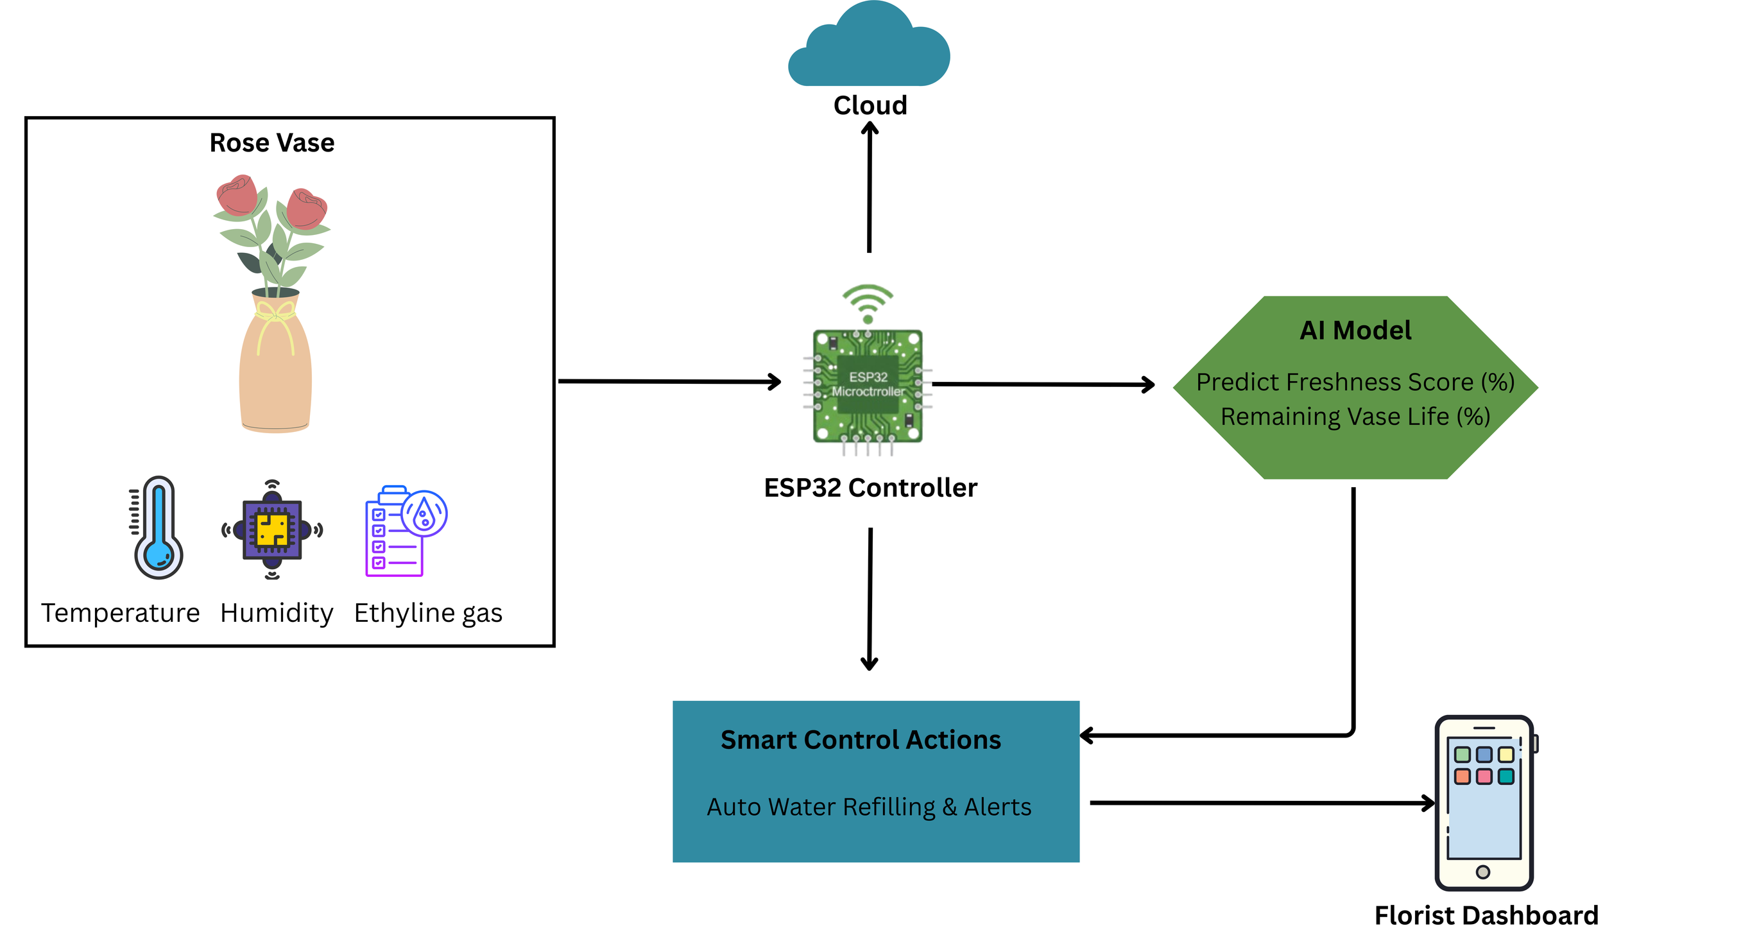

IoT Based Freshness Monitoring & Post harvest Management
03
23
HOW TO USE IN REAL
-WORLD SCENARIO
IT22367594 | BANDARA N G J C | 25-26J-299

Slide 24

Intelligent Nutrition Management for Greenhouse Roses
24
IT22326522 - Perera W P M A N
Information Technology Specialization

Slide 25

Intelligent Nutrition Management for Greenhouse Roses
25
PROBLEM DEFINITION
  Most Sri Lankan rose farmers rely on experience-based fertilizer mixing.
  No predictive system to monitor real-time senser data and predict nutrient stress.
  Overuse or underuse of fertilizers leads to poor flower quality and soil damage.
  High humidity and rainfall in greenhouses cause nutrient loss and salinity buildup.
  Farmers struggle to decide when and how much fertilizer to apply.
IT22326522 | PERERA W P M A N | 25-26J-299

Slide 26
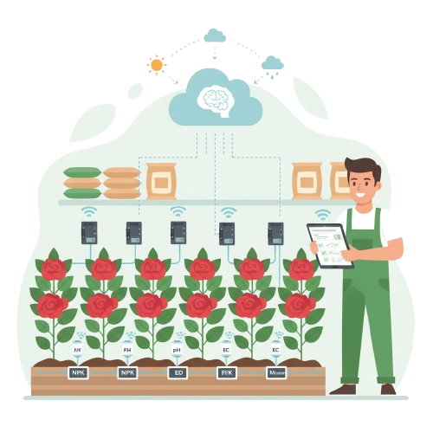
Intelligent Nutrition Management for Greenhouse Roses
02
02
02
26
PROPOSED SOLUTION
  Collects real-time soil & environmental sensor data.
  Predicts future nutrient stress.
  Applies agronomic logic for pH and NPK interpretation.
  Generates stage-aware clear fertilizer recommendations for farmers.
  Weather-aware scheduling for eco-friendly use.
  Mobile application for real-time farmer decision support.
IT22326522 | PERERA W P M A N | 25-26J-299

Slide 27
Intelligent Nutrition Management for Greenhouse Roses
02
02
02
27
Completion and Future works
Completed - 65%
Future works - 35%
  IOT Sensor integration
  EC prediction model
  Nutrient decision logic
  Mobile app integration
  Fertilizer history tracking
  Weather-based fertilizer timing alerts
IT22326522 | PERERA W P M A N | 25-26J-299

Slide 28
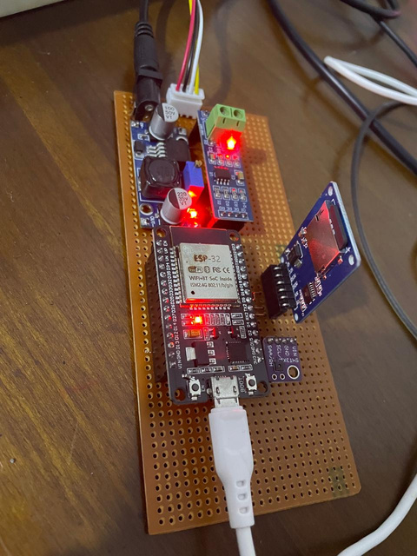
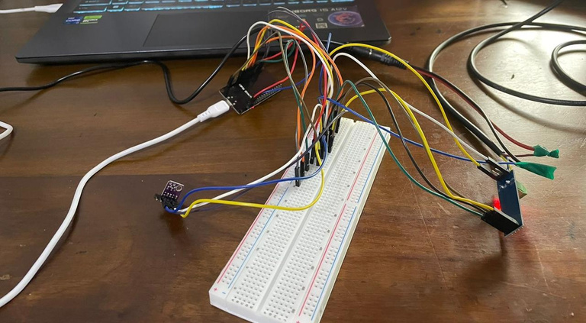
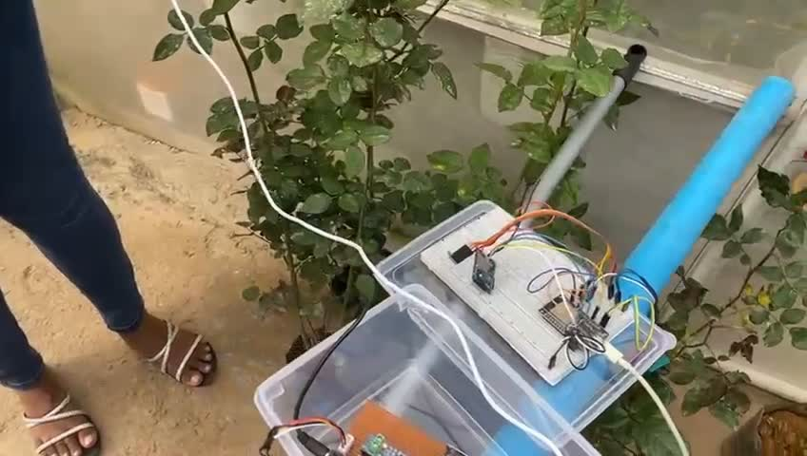
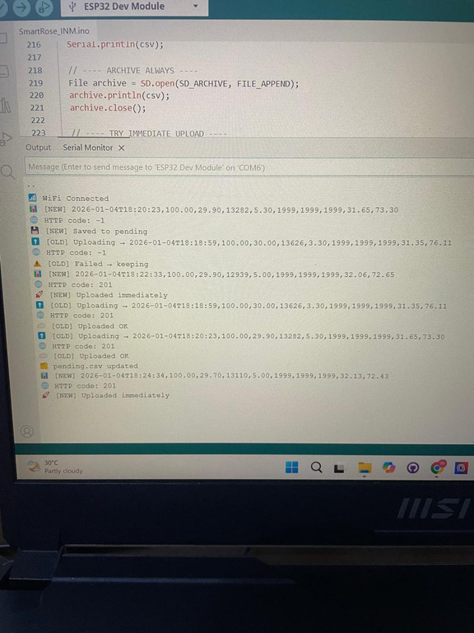
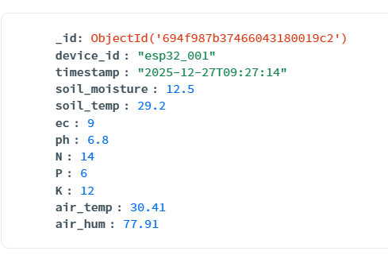
Intelligent Nutrition Management for Greenhouse Roses
02
02
02
28
Evidence of Completion
IOT Integration, Testing and Data collection
IT22326522 | PERERA W P M A N | 25-26J-299

Slide 29
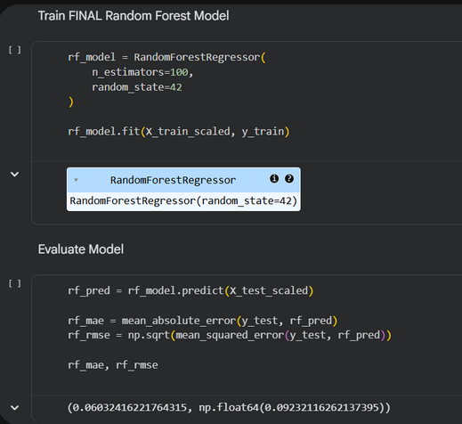
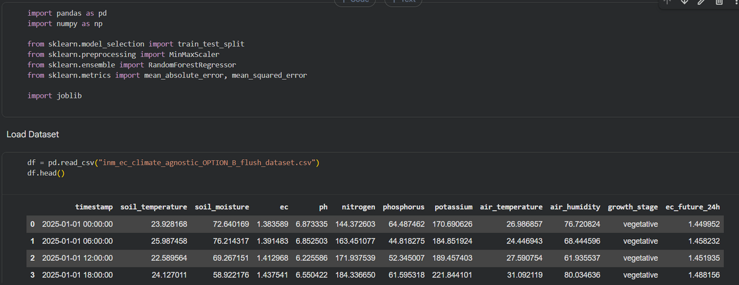
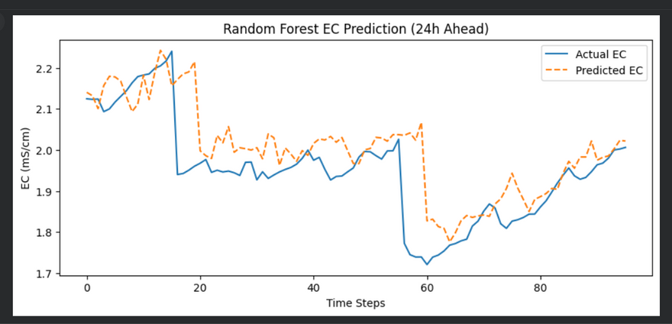
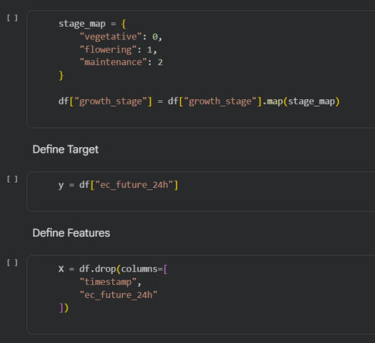
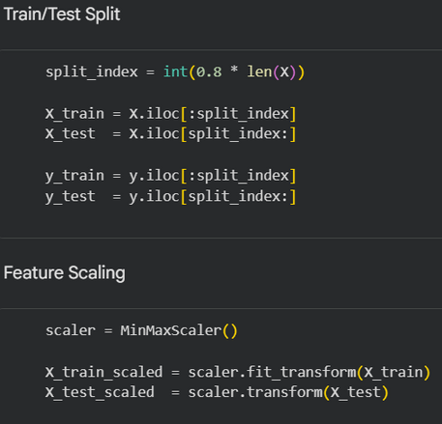
Intelligent Nutrition Management for Greenhouse Roses
02
02
02
29
Evidence of Completion
Data Pre-Processing & Training the model
IT22326522 | PERERA W P M A N | 25-26J-299

Slide 30
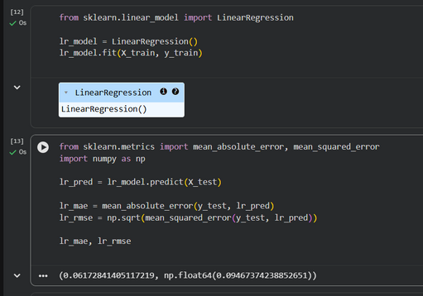
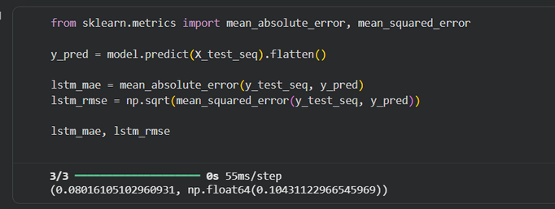
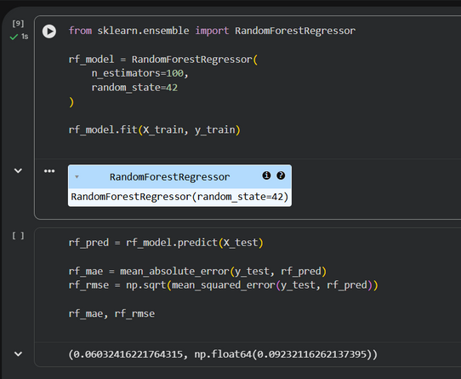
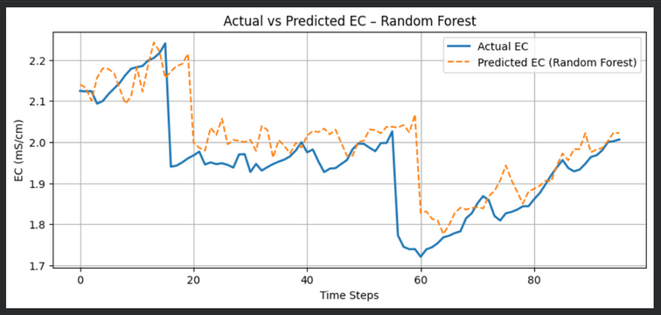
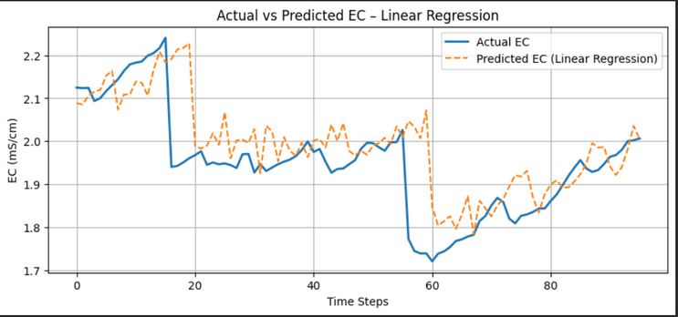
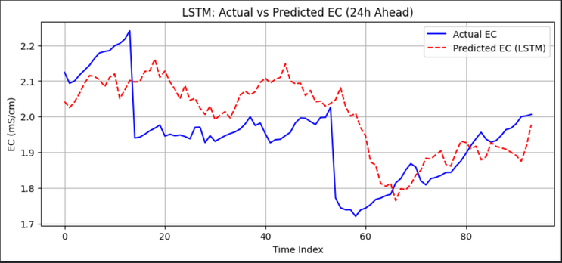
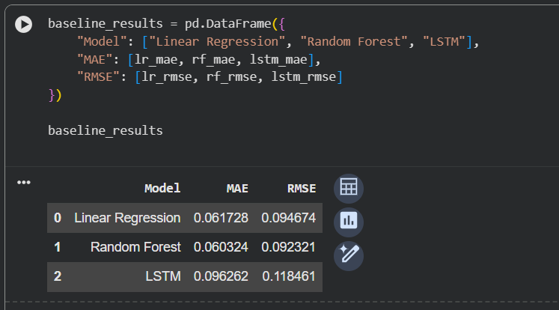
Intelligent Nutrition Management for Greenhouse Roses
02
02
02
30
Selecting Best Model
Linear Regression
LSTM
Random Forest
  Best Model: Random Forest Regressor (Lower MAE & RMSE)
IT22326522 | PERERA W P M A N | 25-26J-299

Slide 31
Intelligent Nutrition Management for Greenhouse Roses
02
02
02
31
Technologies, Techniques, Algorithms
  ESP32
  SHT30
  NPK 7 in 1 soil sensor (N, P, K, EC, pH, Soil Moisture, Soil Temperature)
Hardware
Software
Techniques & Algorithm
  Arduino IDE
  Flutter (Mobile App)
  FastAPI (Backend)
  MongoDB
  Python (ML)
  Google Collab
  Data preprocessing & normalization
  Rule-based nutrient interpretation
  Store-and-forward offline buffering
  Random Forest Regressor
IT22326522 | PERERA W P M A N | 25-26J-299

Slide 32
Intelligent Nutrition Management for Greenhouse Roses
02
02
02
32
Functional, Non-Functional and User Requirements
Functional Requirements
  Real-time Sensor Data Collection.
  Secure Data Storage & History.
  EC Prediction Using Machine Learning.
  Rule-Based Nutrient Interpretation.
  Fertilizer Recommendation Generation.
  Mobile Dashboard & Action Tracking.
Non-Functional Requirements
  Performance - Sensor data processing and fertilizer recommendations must update within a few seconds.
  Usability- Mobile interface must be simple, readable, and usable by non-technical farmers.
  Reliability - System must continue functioning during network failures using offline data buffering.
  Security - Sensor and user data must be securely transmitted and validated via backend APIs.
  Maintainability- Modular architecture allows independent updates to sensors, ML models, and UI.
User Requirements
  View Real-Time Soil & Environmental Data.
  Receive Clear Fertilizer Recommendations.
  Understand Crop Growth Context.
  Receive Alerts & Notifications.
  Reduce Fertilizer Waste & Cost.
IT22326522 | PERERA W P M A N | 25-26J-299

Slide 33
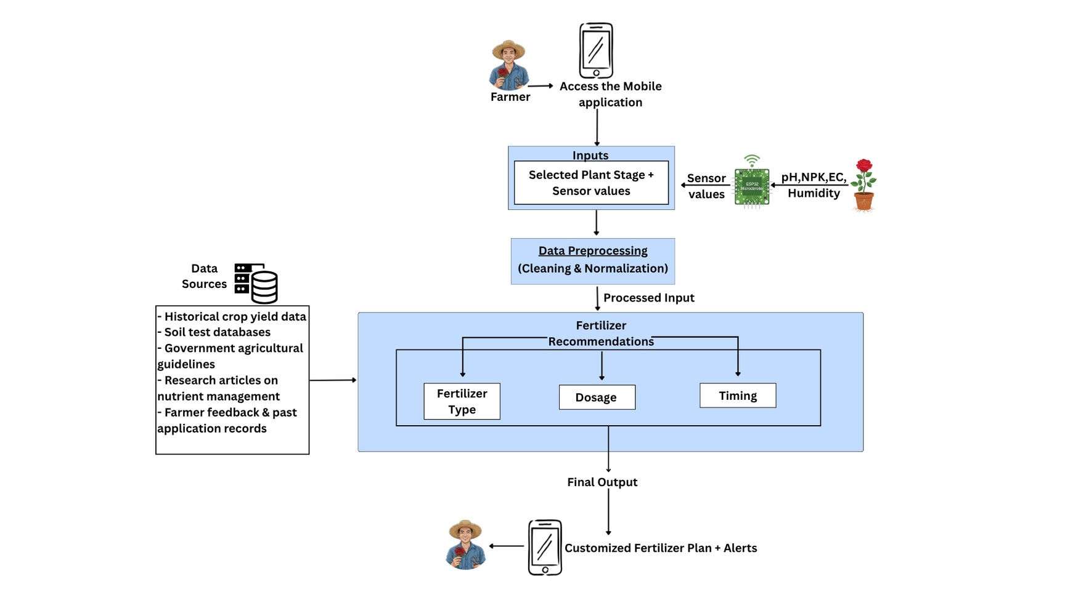
Intelligent Nutrition Management for Greenhouse Roses
33
HOW TO USE IN REAL-WORLD SCENARIO
IT22326522 | PERERA W P M A N | 25-26J-299

Slide 34

34
Centralized Stress Prediction & Energy Optimization System
IT22888648 - RODRIGO U M T H
Information Technology Specialization

Slide 35

Centralized Stress Prediction & Energy Optimization System
35
PROBLEM DEFINITION
  Greenhouse rose farming faces high energy costs.
  Manual monitoring causes delayed stress detection.
  Inefficient control leads to energy waste & plant stress.
IT22888648 | RODRIGO U M T H | 25-26J-299

Slide 36
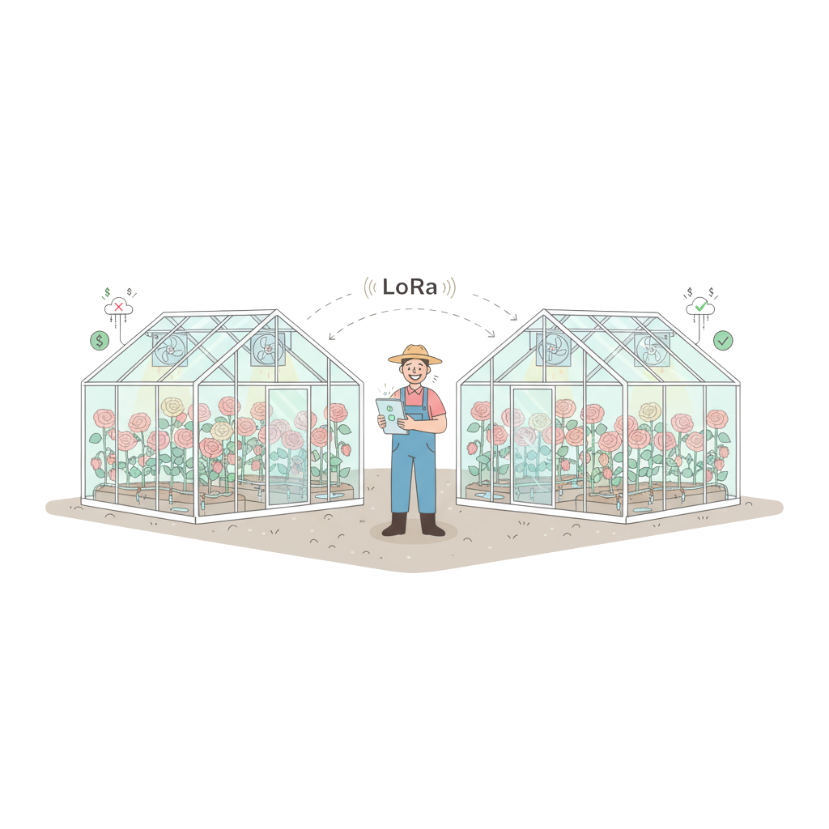
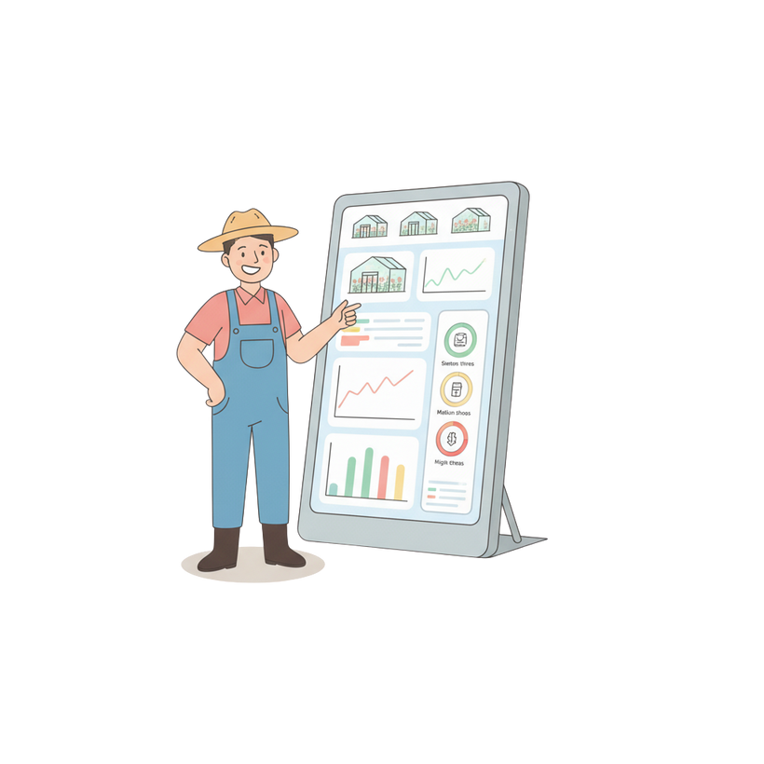
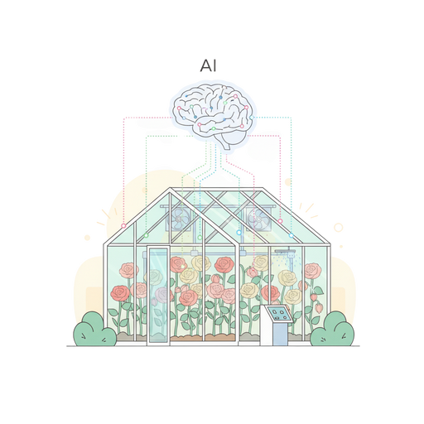
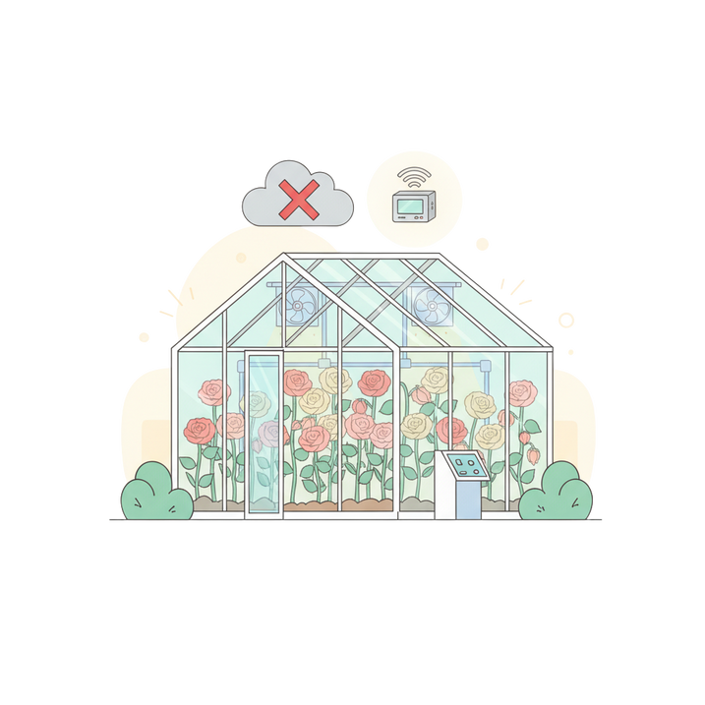
Centralized Stress Prediction & Energy Optimization System
36
PROPOSED SOLUTION
  Centralized LoRa-based greenhouse monitoring.
  ML model predicts plant stress levels.
  AI-assisted energy optimization suggestions.
  Mobile dashboard for alerts & insights.
  Supports offline operation.
IT22888648 | RODRIGO U M T H | 25-26J-299

Slide 37
Centralized Stress Prediction & Energy Optimization System
02
02
02
37
COMPLETION AND FUTURE WORKS
Completed - (75%+)
Ongoing / Next Phase
  IoT sensor integration
  Real-time data ingestion
  Stress prediction ML model
  Database & API integration
  Mobile UI for visualization
  Energy optimization ML
  UI enhancements
IT22888648 | RODRIGO U M T H | 25-26J-299

Slide 38
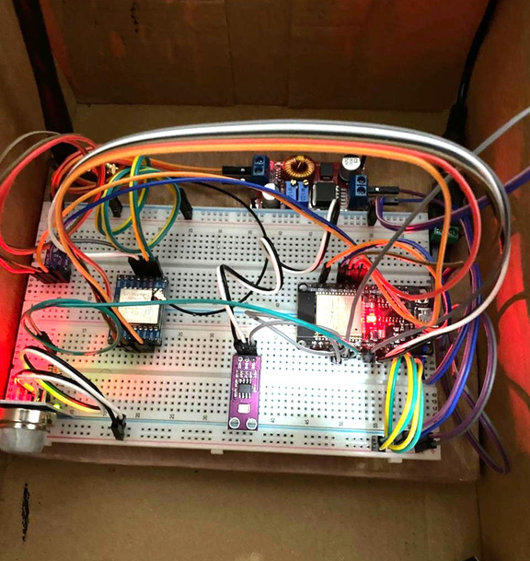
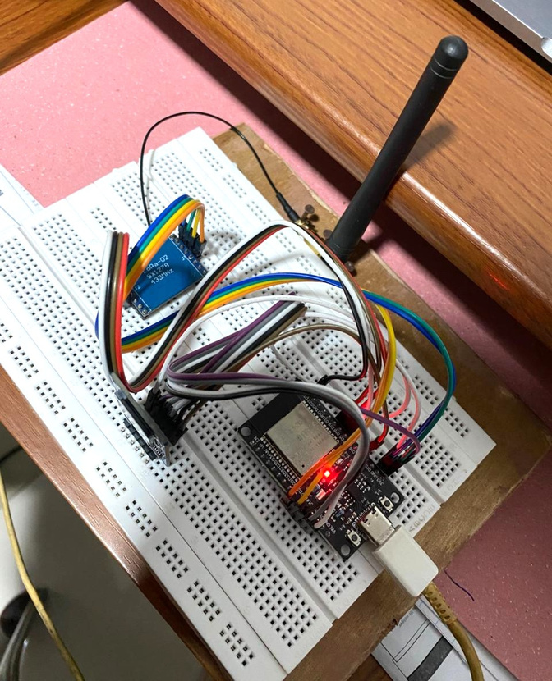


Centralized Stress Prediction & Energy Optimization System
02
02
02
38
EVIDENCE OF COMPLETION
IOT Integration and Testing
IT22888648 | RODRIGO U M T H | 25-26J-299

Slide 39



Centralized Stress Prediction & Energy Optimization System
02
02
02
39
Evidence of Completion
Data Pre-Processing & Training the model
Stress Prediction Model
  Type: Machine Learning (Random Forest Classifier)
  Inputs: Temperature, Humidity, UV, Soil Moisture, Air Quality
  Output: Plant Stress Level → LOW / MEDIUM / HIGH
  Purpose: Detection of plant stress
  Performance: ~86% accuracy on sensor data
IT22888648 | RODRIGO U M T H | 25-26J-299

Slide 40
Centralized Stress Prediction & Energy Optimization System
02
02
02
40
TECHNOLOGIES, TECHNIQUES, ALGORITHMS
  Arduino IDE
  FastAPI
  MongoDB
  Python
  Google Colab
  Flutter
  ESP32 Dev Board
  LoRa RA-02
  SHT30 Sensor
  GUVA-S12SD UV Sensor
  Capacitive Soil Moisture Sensor
  MQ-135 Sensor
Software
Hardware
  Data preprocessing & normalization
  Random Forest Classifier (Stress Prediction)
  Store-and-forward offline buffering
  REST API - based ML inference
Techniques & Algorithm
IT22888648 | RODRIGO U M T H | 25-26J-299

Slide 41
Centralized Stress Prediction & Energy Optimization System
02
02
02
41
Functional, Non-Functional and User Requirements
Functional Requirements
Non-Functional Requirements
  Real-time environmental sensor data collection
  Stress level prediction using ML
  AI-assisted energy optimization recommendations
  Secure data storage & history tracking
  Mobile dashboard for alerts & recommendations
  Performance - Predictions generated within seconds
  Reliability - Operates during network failures (offline buffering)
  Usability - Simple, farmer-friendly mobile interface
  Security - Secure API communication & data storage
  Maintainability - Modular ML, backend & UI architecture
User Requirements
  View real-time greenhouse conditions
  Receive clear stress alerts (LOW / MEDIUM / HIGH)
  Get energy-saving suggestions
  Understand greenhouse status easily
  Reduce energy usage & operational cost
IT22888648 | RODRIGO U M T H | 25-26J-299

Slide 42

Centralized Stress Prediction & Energy Optimization System
42
HOW TO USE IN REAL-WORLD SCENARIO
IT22888648 | RODRIGO U M T H | 25-26J-299

Slide 43



Snaps from Field Visits
43

Slide 44

Demo
44

Slide 45
45
Thank You !

